Slide 1

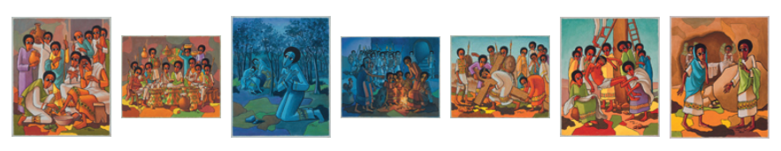
Slides to accompany
First published by ROOTS for Churches in Issue 100 March-April 2019.
©ROOTS for Churches Ltd. Resources to use with these paintings are at www.rootsontheweb.com/passionofchrist2019

Slide 2
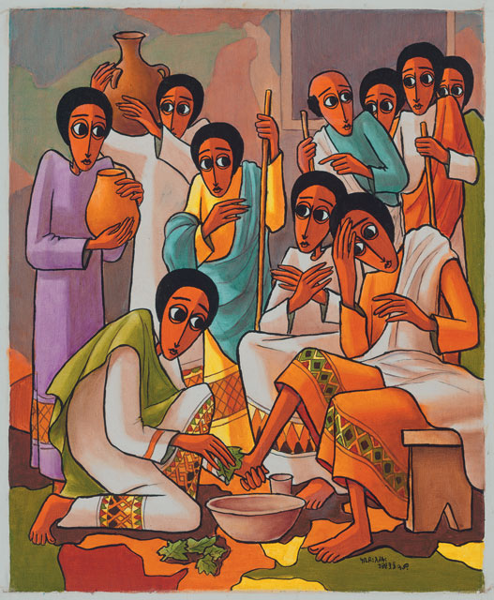
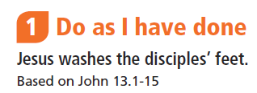
©ROOTS for Churches Ltd. Resources to use with these paintings are at www.rootsontheweb.com/passionofchrist2019

Slide 3
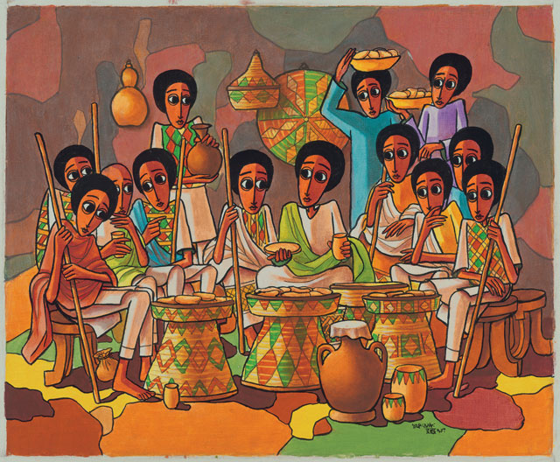
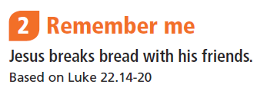
©ROOTS for Churches Ltd. Resources to use with these paintings are at www.rootsontheweb.com/passionofchrist2019

Slide 4
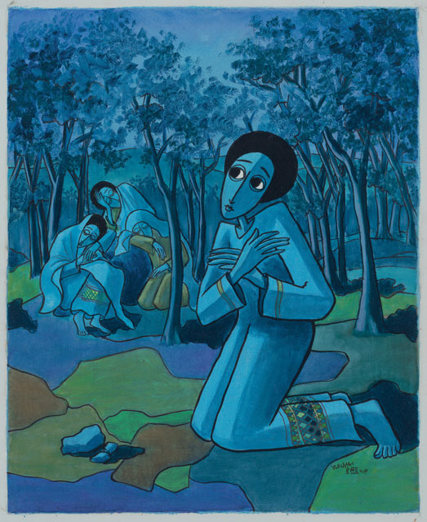
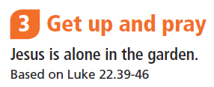
©ROOTS for Churches Ltd. Resources to use with these paintings are at www.rootsontheweb.com/passionofchrist2019

Slide 5
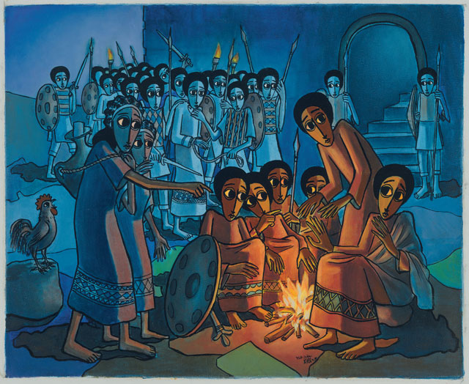
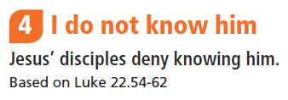
©ROOTS for Churches Ltd. Resources to use with these paintings are at www.rootsontheweb.com/passionofchrist2019

Slide 6
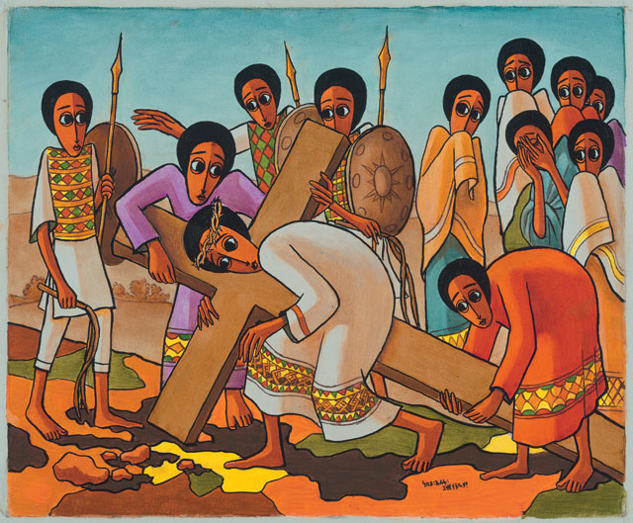
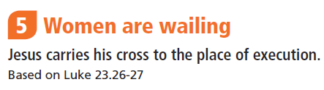
©ROOTS for Churches Ltd. Resources to use with these paintings are at www.rootsontheweb.com/passionofchrist2019

Slide 7
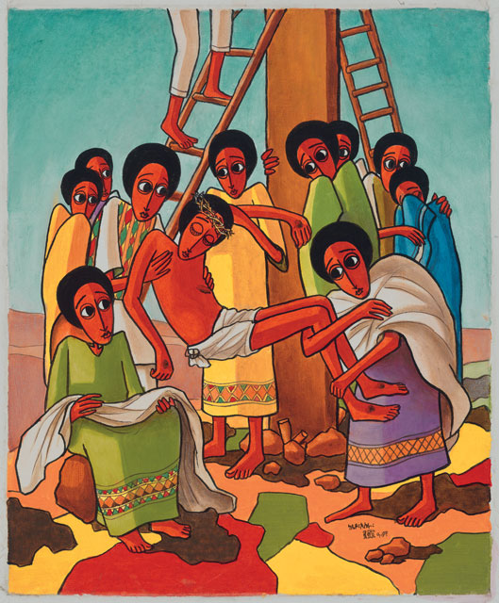
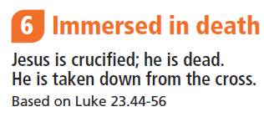
©ROOTS for Churches Ltd. Resources to use with these paintings are at www.rootsontheweb.com/passionofchrist2019

Slide 8
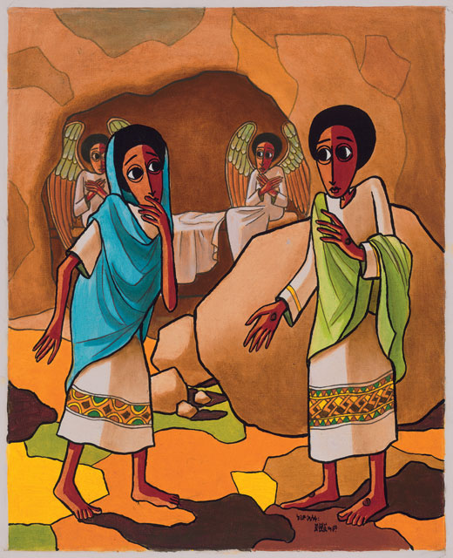
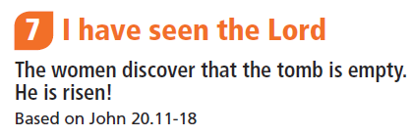
©ROOTS for Churches Ltd. Resources to use with these paintings are at www.rootsontheweb.com/passionofchrist2019

